Slide 1


Flood Analysis
Analysing the impact of climate change on Queensland agriculture, intermediated by increased flood events

Slide 2




Breakdown of analysis
Taryn Question 1: Understand the shape of flooding and rainfall data over time | Van Question 2: Understand temperature as a driver of flooding | Anna Question 3: Understand the impact of flooding on cattle headcounts and saleyard prices | Tom Question 4: Forecast the impact of climate change on sugarcane yields

Slide 3


Understand the shape of flooding and rainfall data over time
Hypotheses
- Increase in river discharge means increased flood risk across both cities
- The frequency of rainfall has increased over time
- The frequency of floods has increased over the last 3 decades
**Definitions**
- River discharge is the volume of water flowing through a river channel. This is the total volume of water flowing through a channel at any given point and is measured in cubic metres per second (cumecs). The discharge from a drainage basin depends on precipitation, evapotranspiration and storage factors. Drainage basin discharge = precipitation – evapotranspiration +/- changes in storage.
Data sources
- Open Meteo Flood API (GloFAS), 1990-2020, Queensland
- https://www.internetgeography.net/topics/river-discharge/
**Visualisation**
- River discharge time series
- Rainfall over time series

Slide 4
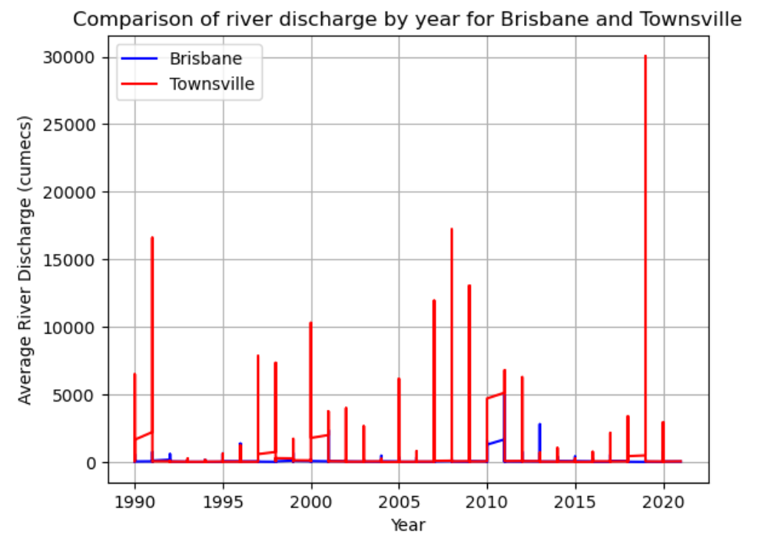
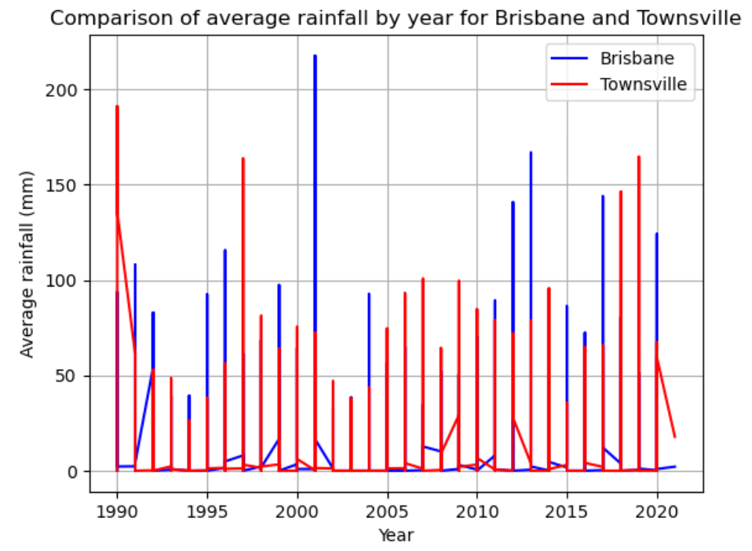
Flood and rainfall data over time
Average river discharge by year
Average rainfall per year

Slide 5
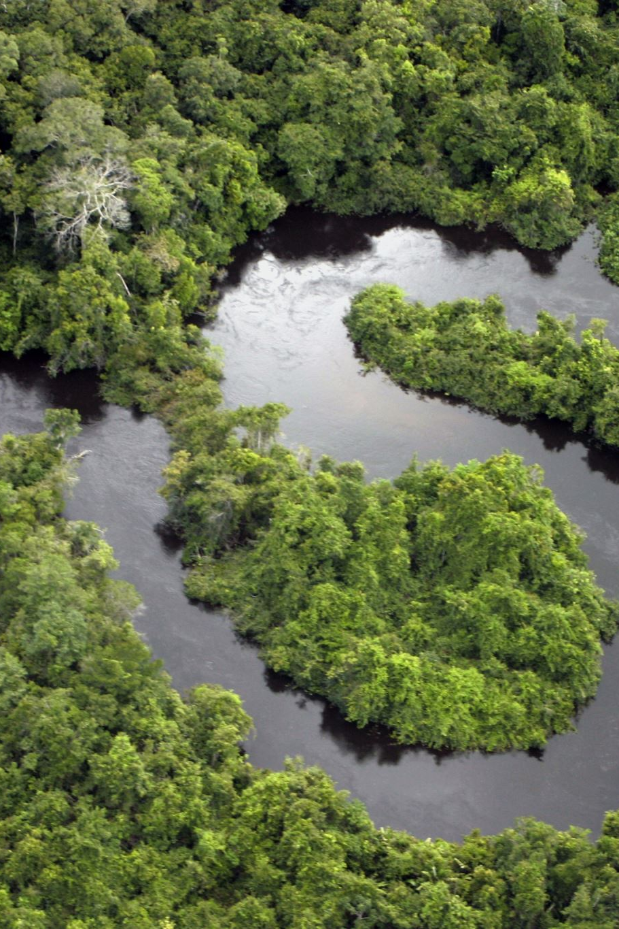
Analysis
The average rainfall for Brisbane is higher than Townsville
The average river discharge which can be the assumed as flood risk is greater in Townsville compared to Brisbane even though the average rainfall is higher in Brisbane
We can conclude a null hypothesis that increased rainfall equals increased river discharge and therefore flood risk for the two cities
River discharge has not increased in severity over time, there is no pattern for higher than average river discharge for either city resulting in a null hypothesis
Rainfall average mm has increased above 75mm in the last 10 years compared to previous years where there were peaks above 150 and dips below 50. Average rainfall has been consistently more severe from 2010 - 2020 compared with 1990 to 2010 where there are 3 sharp peaks and lower average rainfall.

Slide 6
Understander Temperature as a driver of Flooding.
Hypotheses:
Hotter weather leads to more flooding (more severe, more frequent)
Data sources
Open Meteo Flood API (GloFAS) 1990-2020
Open Meteo Weather API
Visualisation
Temperature time series
Flooding time series

Slide 7
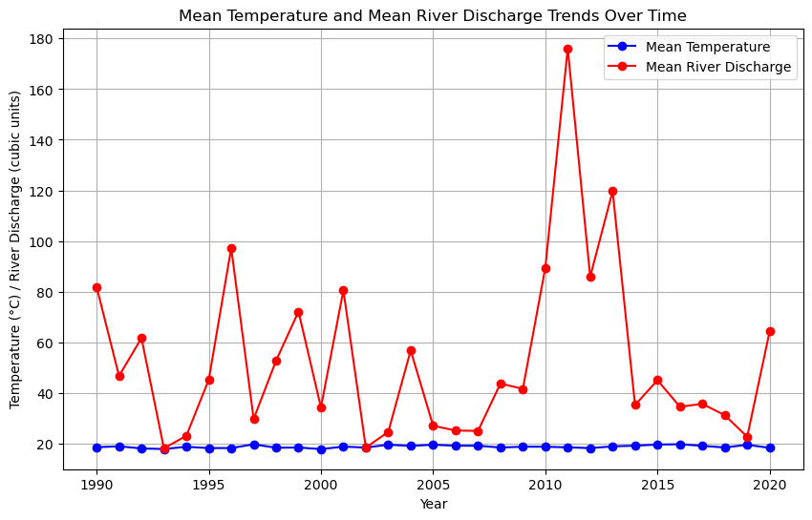
Mean Temperature and Mean River Discharge Over Time.
Over the observed period, there is no substantial trend in the mean temperature values, suggesting little change over time.
The river discharge has experienced considerable changes over the observed period.

Slide 8
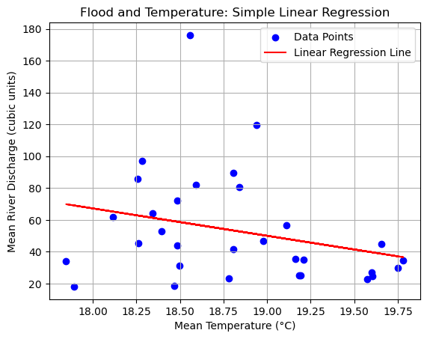
Analysis of Flood and Temperature: Linear Regression Insights
Equation of the line: Flood = 376.96 + -17.21 * Temperature

Slide 9
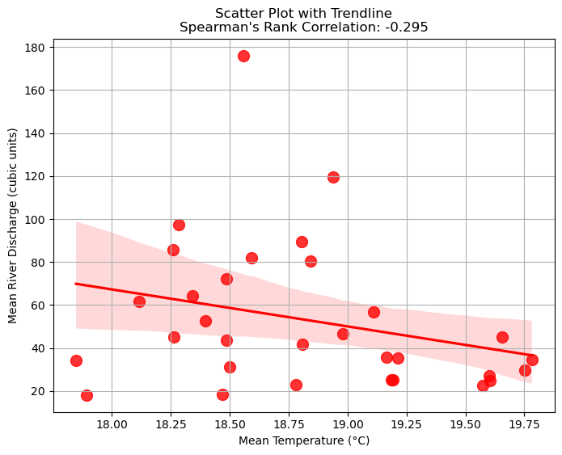
Scatter Plot of Mean Temperature and Mean River with Trendline
Spearman's rank correlation coefficient is a statistical measure that quantifies the strength and direction of the monotonic relationship between mean temperature and mean river discharge.

Slide 10
Analysis
In conclusion, there is no significant relationship between temperature changes and river discharge over the observed period. Temperature fluctuations do not appear to have a substantial impact on river discharge.

Slide 11
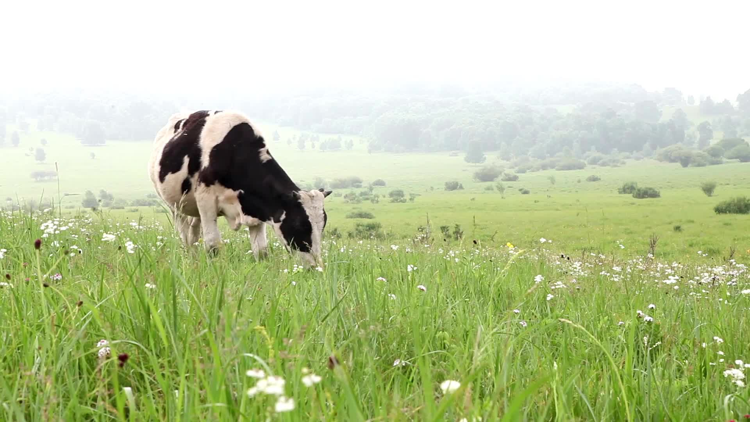
Impact of flooding on cattle headcounts and saleyard prices
Flooding is known to damage and destroy pasture and stock crops, and cause disease among livestock
As well as losing cattle to disease, farmers may need to cull stock to reduce the load on remaining pasture and feed
As Queensland produces over 40% of all Australian cattle, any major impact on cattle numbers in this region is likely to be reflected in overall Australian market cattle prices.
One major indicator of local market prices is the per kg price of yearling cattle at saleyards
Hypotheses:
Cattle numbers will reduce in response to flooding due to lack of feed and disease among livestock
Saleyard prices will increase in response to lower cattle numbers for sale
Data sources
Open Meteo Flood API (GloFAS), yearly 1990-2020, Queensland
Cattle herd size and saleyard prices data was obtained from the Australian Bureau of Statistics

Slide 12
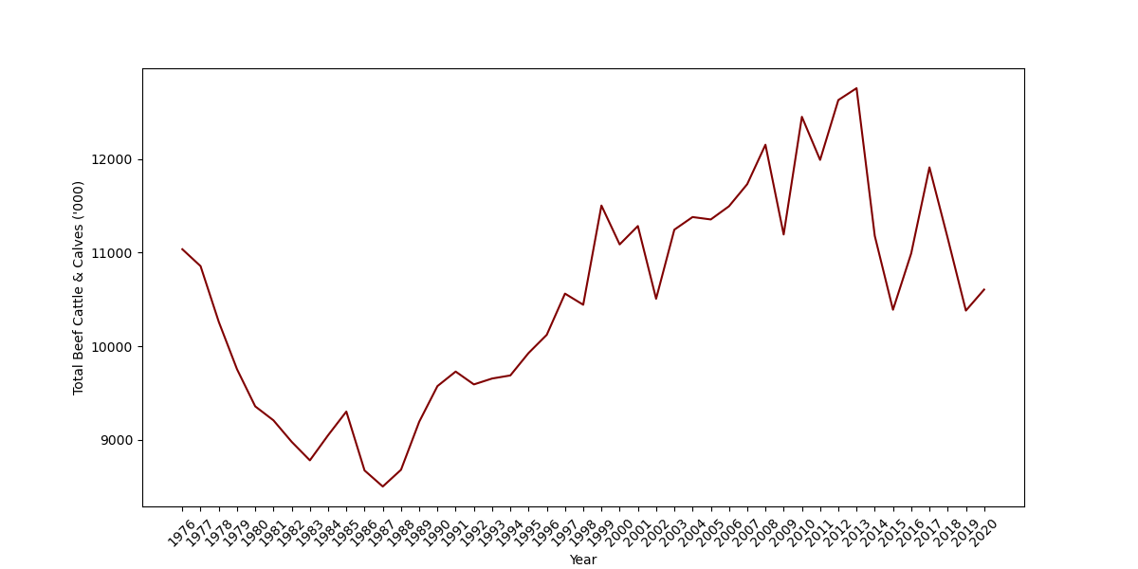
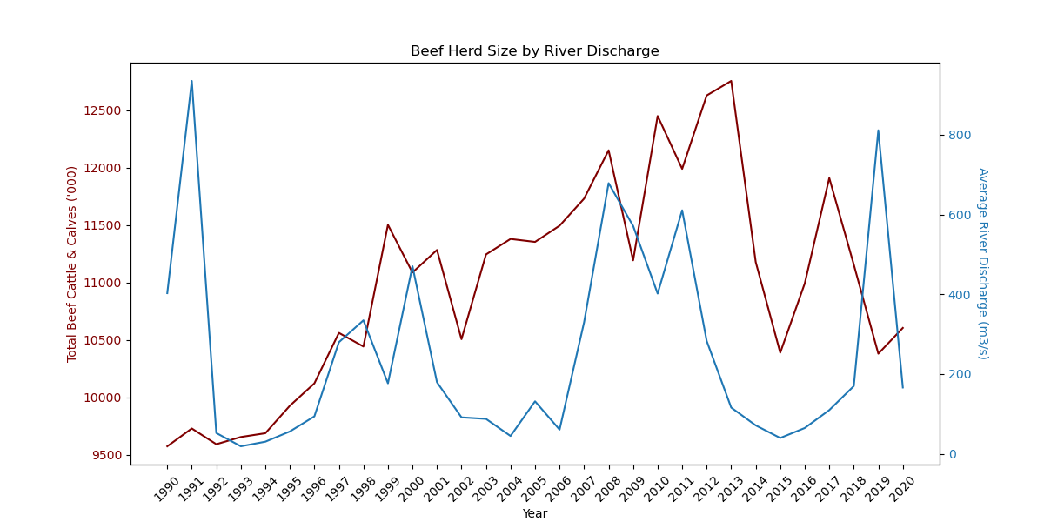
Impact of flooding on cattle headcounts and saleyard prices
Queensland beef herd size 1990-2020
Herd size by flooding

Slide 13
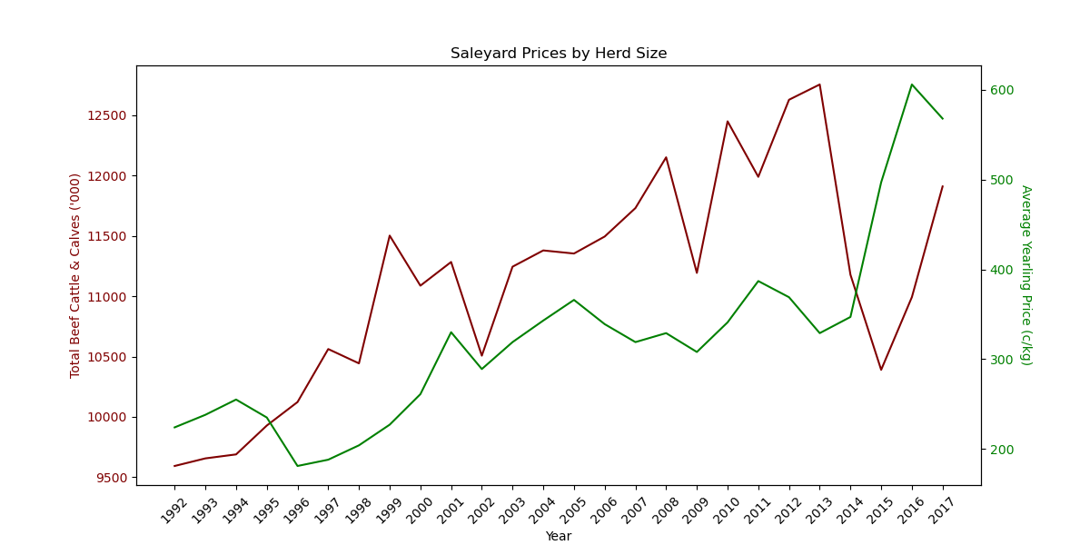
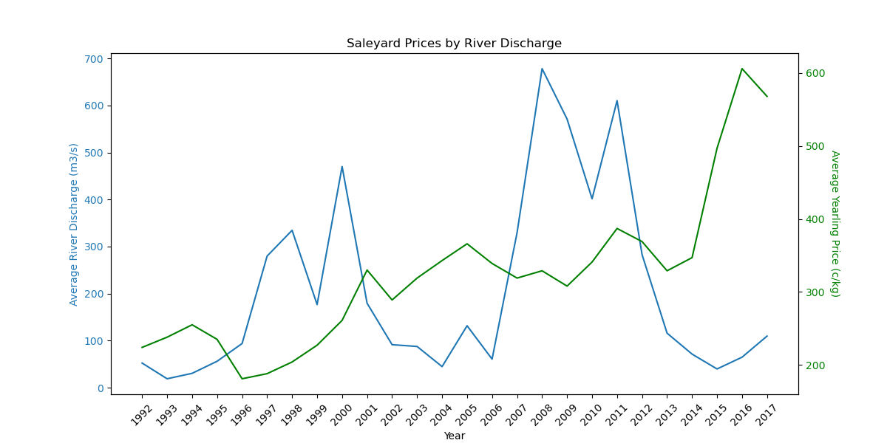
Impact of flooding on cattle headcounts and saleyard prices
Saleyard prices by herd size
Saleyard prices by river discharge

Slide 14
Analysis
Flooding does impact herd size and saleyard prices but ONLY when cattle numbers before the flood are high.
Drought has a more significant impact than flooding.
There may be an “optimum” herd size that is manageable through adverse weather events.

Slide 15
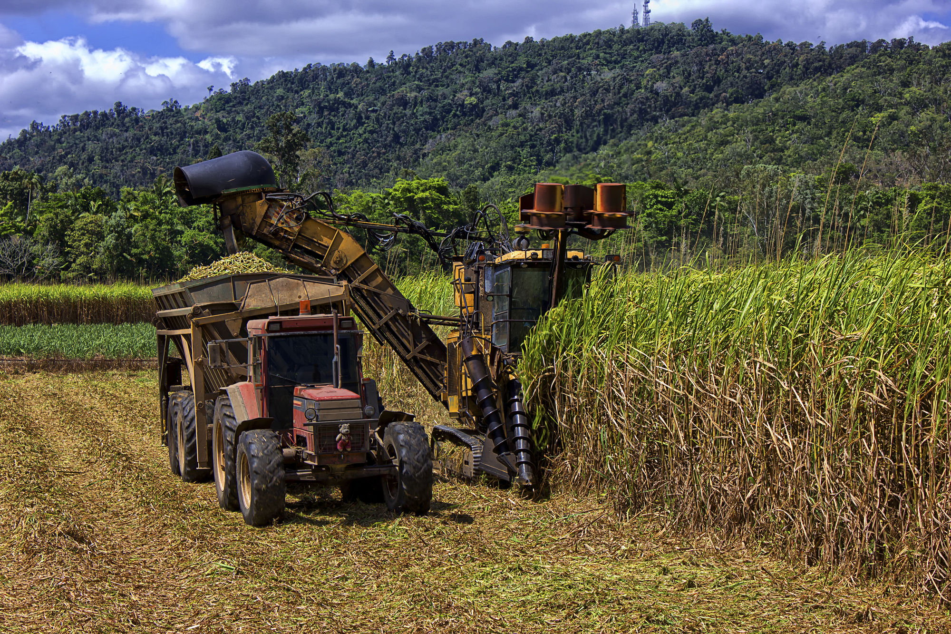
Forecasting sugar cane yields to 2040
Hypotheses
Rising global temperatures will increase sugar cane yields in cooler climates
Data sources
Open Meteo Weather API
Australian Sugar Milling Council production data (2014 to 2021)
Open Meteo Climate Change forecast API (from 2040)
Visualisation
Prediction of sugar cane yields in Queensland

Slide 16
Background
Australia has a $2B sugar export industry
95% of Australian sugar cane is produced in Queensland's Northern Coastal areas, where yields depend on the wet, rainy summers
Climate change will have an impact on weather, which may impact yields
Sugar mills range down Queensland's Eastern coast. An initial hypothesis is that more Southerly mills will see increased yields, while more Northerly mills may be adversely affected

Slide 17
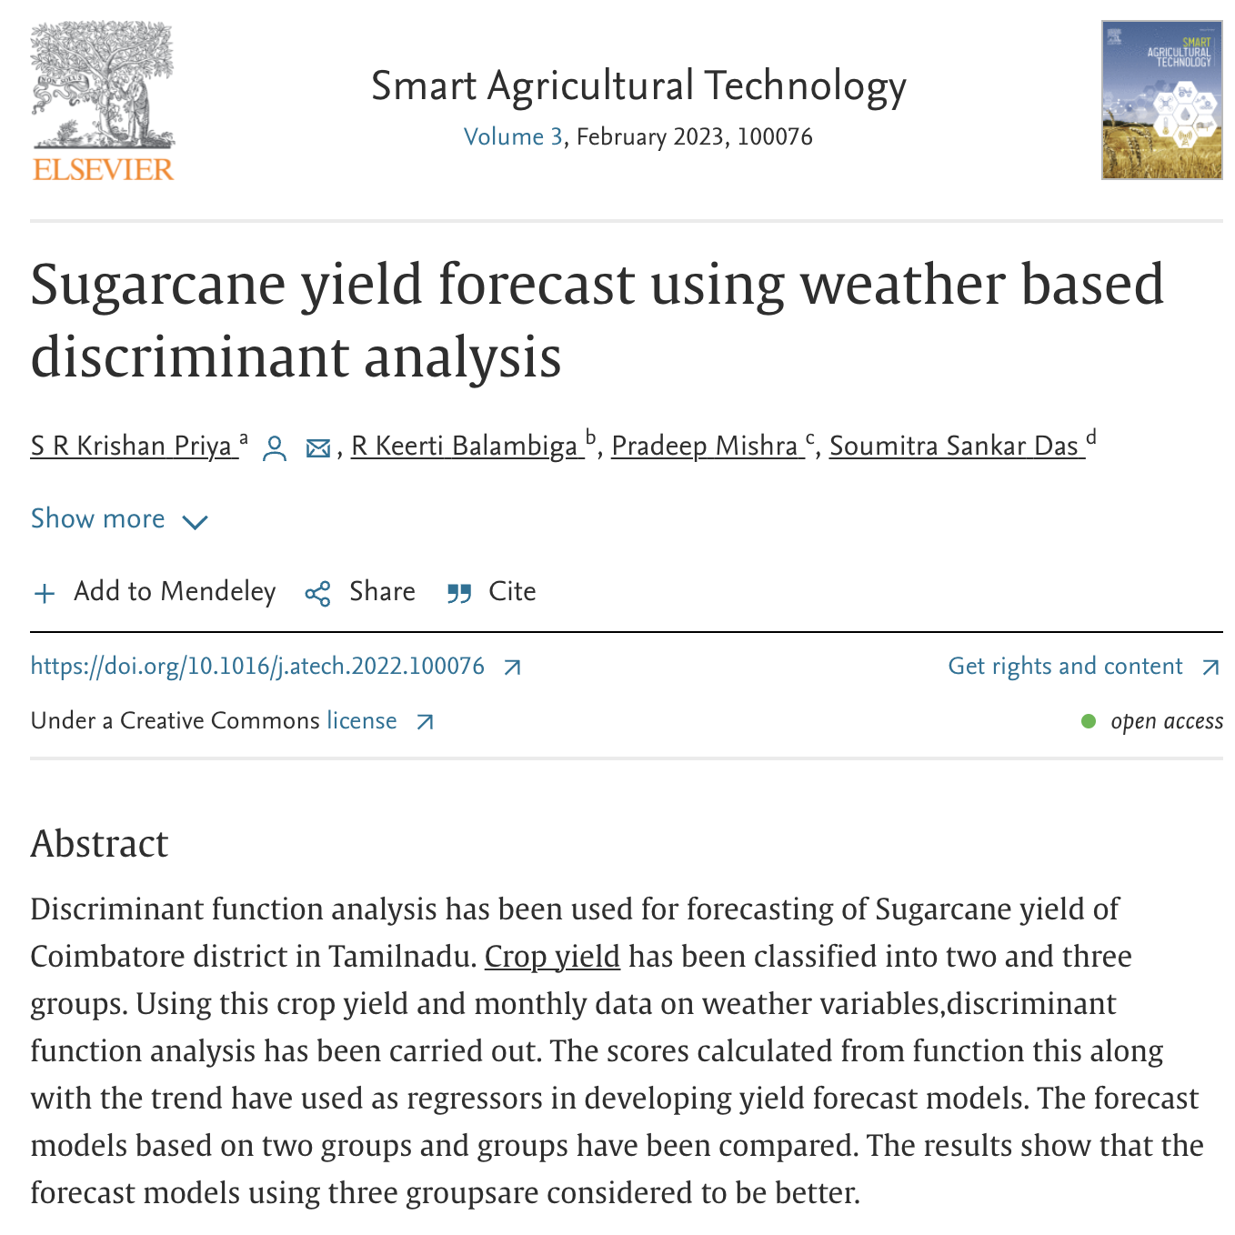
Method
Obtain weather and yield data for existing sugar mills
Construct a model to predict high and low sugar cane yield years, from the weather
Use predictive climate models to predict the weather for these sites in 2040
Assess the expected change in yields for these sites
Loosely follow a modelling methodology in Priya et al 2022

Slide 18

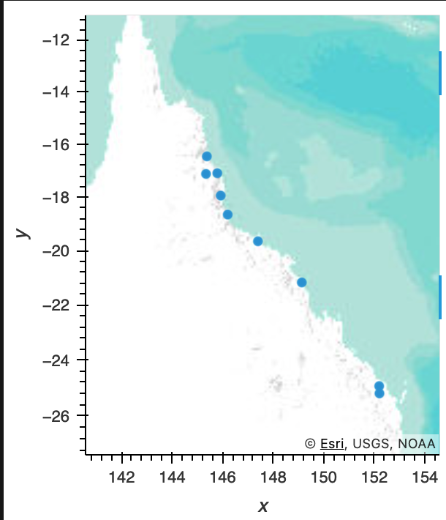
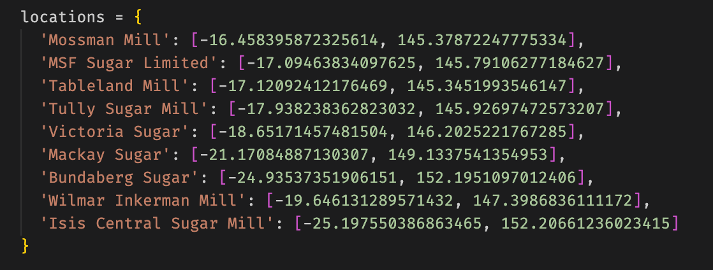
Locations

Slide 19
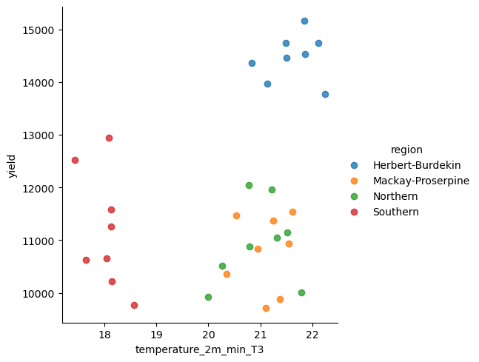
Yields are impacted most by late-year temperature

Slide 20
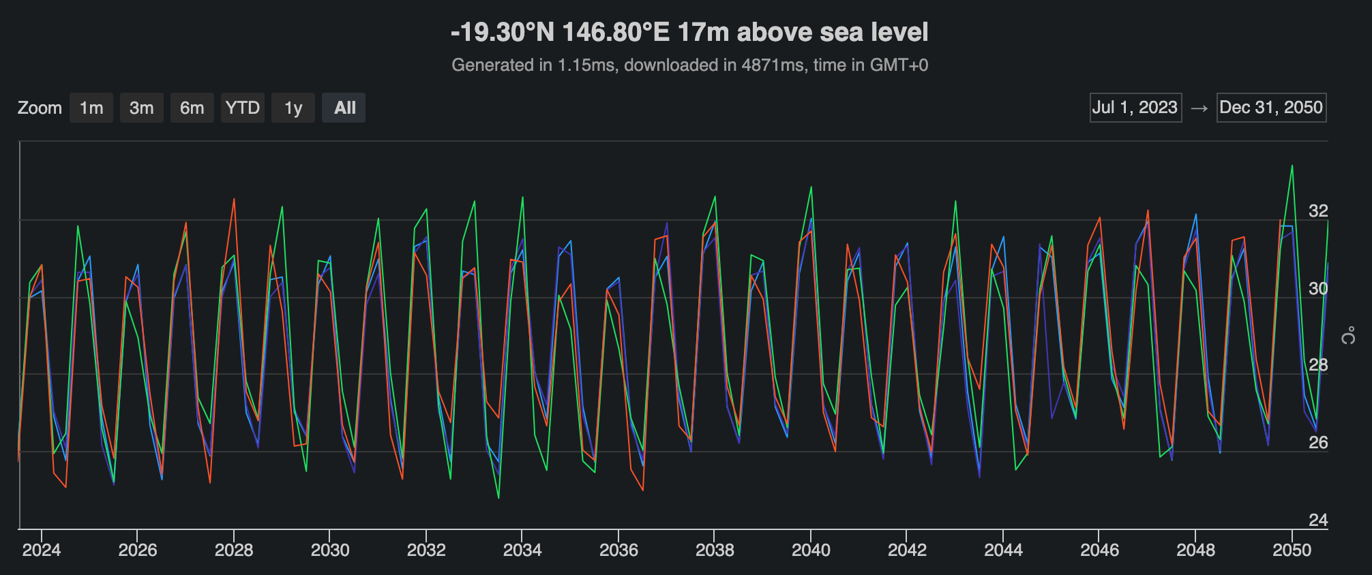
Long-range climate forecast data

Slide 21
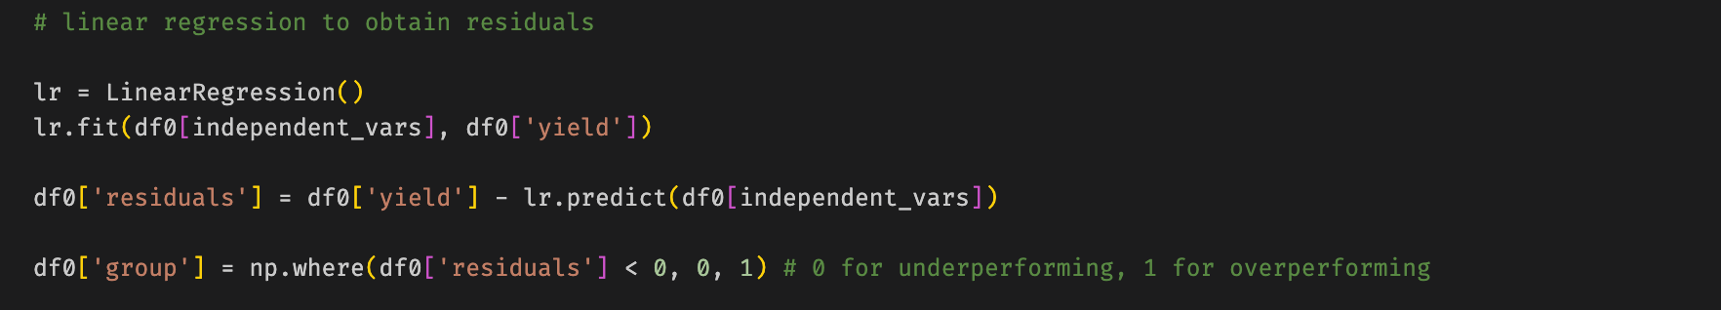
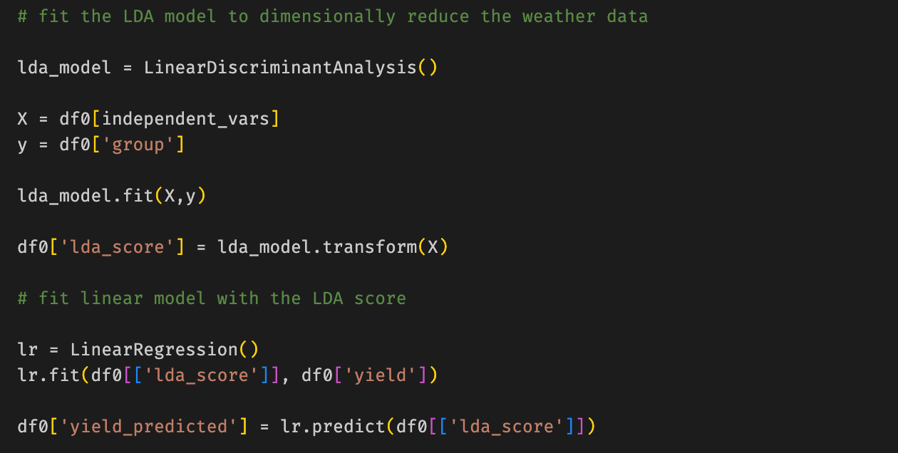
Linear Discriminant Analysis

Slide 22
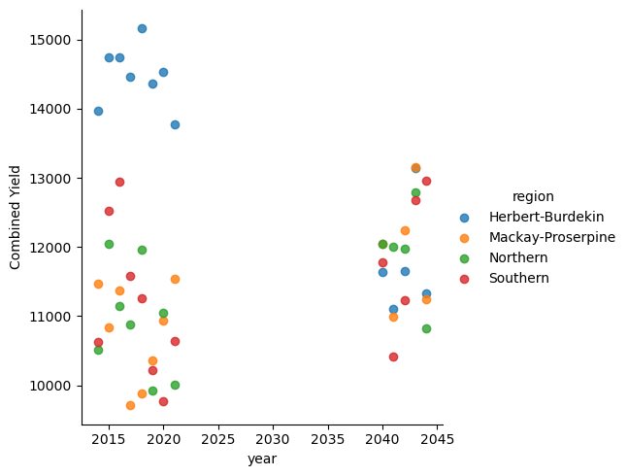
Forecast against weather in 2040s

